Slide 1
Portfolio Risk Management
Presenters
Saishree Mali – A003
Pratik Daga – A006
Annu Dhankhar – A022
Surabhi Sonje – A025
Sanchita Mayekar – A026
Under the mentorship of –
Ms Akshita Mamania
- Cassandra Asset Management

Slide 2
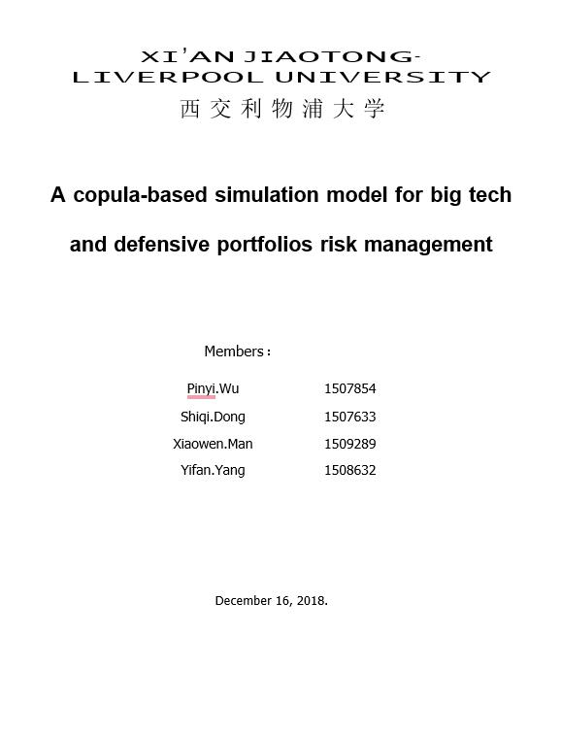
Research Paper :
A copula-based simulation for big tech and defensive portfolios risk management.
By :
Pinyi.Wu, Shiqi.Dung, Xiaowen.Man, Yifan.Yang
Published on December 16, 2018

Slide 3
Objective
1. Making portfolio on the basis of α and β values using Nifty 50 Index and Treasury bills.
2. Comparison of 3 Portfolios : Aggressive, Defensive, Rising Giants on the basis of their returns.
3. Optimisation of portfolio and generalization.

Slide 4
Analysis
General
Plot
Correlation
Technical
Beta
Alpha
Copula
Portfolio
Fitting
Checking best fit distribution
GARCH(1,1)
Drawdowns
Cumulative returns
Optimisation
Comparison
Real life example

Slide 5
Selected Stocks
Reliance (Oil & Gas)
Tata Consultancy Services (IT)
HDFC Bank (Finance)
Bajaj Finservice ltd (Finance NBFC)
Sun Pharma (Pharmaceutical)
Indian Oil Corporation Ltd (Oil & Gas)
Rajesh Export (Precious Metals)
Hindustan Uniliver (FMCG)
Laurus Labs Ltd (Pharma)
Finolex Industries Ltd (Plastics & Pipe)
Suprajit Engineering Ltd (Auto Parts)
Sonata Software Ltd (IT Services & Consulting)

Slide 6
Financial Risks
Credit Risk
Market Risk
01
03
Market risk is what happens when there is a substantial change in the particular marketplace in which a company competes.
Credit risk is when companies give their customers a line of credit; also, a company's risk of not having enough funds to pay its bills.
Liquidity Risk
Operational Risk
02
04
Liquidity risk refers to how easily a company can convert its assets into cash if it needs funds; it also refers to its daily cash flow.
Operational risks emerge as a result of a company's regular business activities and include fraud, lawsuits, and personnel issues.

Slide 7
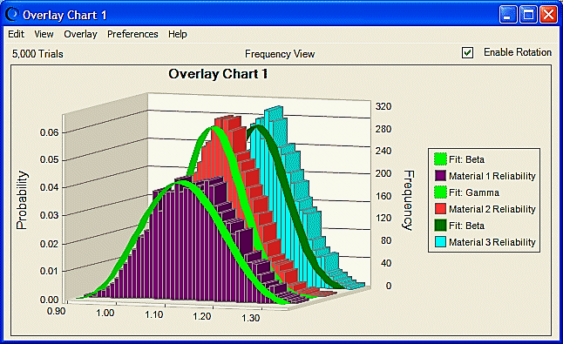
Copula
Copulas were identified as the functions that join or couple Multivariate distribution functions to their uniform one-dimensional marginal distribution functions.
Copula is a new methodology that measures dependence between random variables and also is used in the study of characteristics of financial markets, portfolio aggregation, and risk analysis.

Slide 8

Value At Risk
Value-at-risk (VaR) is a powerful tool that can assess market risk in real-time, which provides important suggestions when making decisions in trading and hedging.
Although VaR has good performance in market risk management and was adopted as standard risk analysis in the financial area.
VaR (Variance - Covariance method) = -(µ + Zα * $σ)$

Slide 9

Coffee can investing refers to the “buy and forget” approach to investing in the stock Market . It is a low-risk method to create enormous wealth by buying a particular stock quantity at a specific price and then holding them for at least ten years to generate high returns.
Primarily, coffee can investing is a long-term investment strategy suitable for passive investors with an investment horizon of more than a decade.

Slide 10
Selection Criteria of Stocks for Rising Giants Portfolio
Market Capitalization > 4000 Cr
Free Cash Flow > 250 Cr (last 5 years)
ROE >= 15% (last 5 years)
ROCE >= 15% (last 5 years)
Low Debt / Equity <= 0.5
MOAT

Slide 11
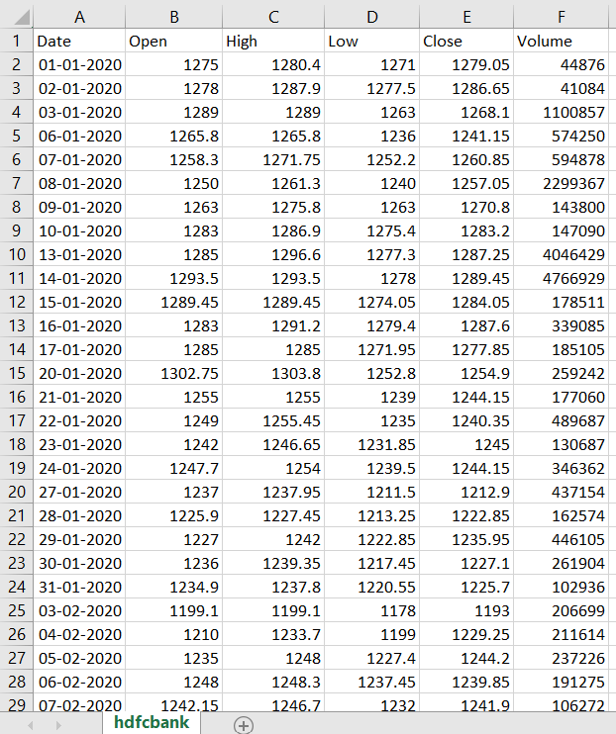
Data Snapshot

Slide 12
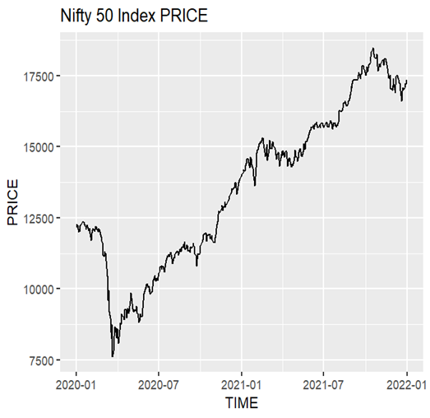
Nifty 50
The NIFTY 50 is a benchmark index that
represents the weighted average of 50 of the
largest Indian companies listed on the
National Stock Exchange.

Slide 13
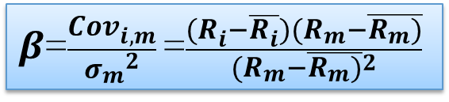
Beta Values
$β$=$\frac{{Cov}_{i,m}}{{σ_{m}}^{2}}$ =$\frac{(R_{i}−\overline{R_{i}})(R_{m}−\overline{R_{m})}}{{(R_{m}−\overline{R_{m})}}^{2}}$
Beta coefficient (β), a widely used method to evaluate risk, it is employed to measure the risk volatility concerning the required return of a specific asset compared to the volatility of the average of the overall market portfolio.

Slide 14
Beta Comparison
AGGRESSIVE PORTFOLIO :
RELIANCE | TATA CONSULTANCY SERVICES | HDFC BANK | BAJAJ FINSERVICE LTD | PORTFOLIO BETA
1.103569 | 0.7246668 | 1.099369 | 1.345164 | 1.0681922
DEFENSIVE PORTFOLIO :
SUN PHARMA | INDIAN OIL CORPORATION LTD | RAJESH EXPORT | HINDUSTAN UNILIVER | PORTFOLIO BETA
0.6665866 | 0.7678764 | 0.2969597 | 0.5629717 | 0.5735986
RISING GIANTS PORTFOLIO :
LAURUS LABS LTD | FINOLEX INDUSTRIES LTD | SUPRAJIT ENGINEERING LTD | SONATA SOFTWARE LTD | PORTFOLIO BETA
0.3359925 | 0.2053599 | 0.2442656 | 0.2459112 | 0.257865425

Slide 15
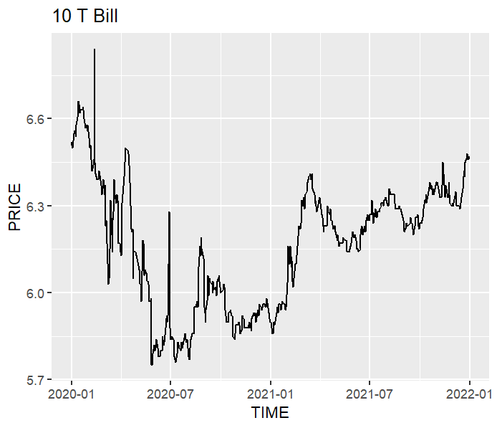

Treasury Bills
A Treasury Bill is a form of bond.
A bond is a securitized loan made by an investor to a borrower who is usually a corporation or a government entity.
Mean of closing prices ($R_{f}$) = 6.159333

Slide 16
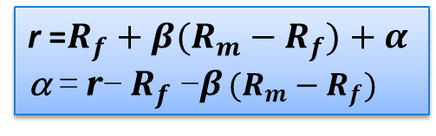
Alpha Values
r =$R_{f}+β(R_{m}−R_{f})+α$
α = r− $R_{f}$−β $(R_{m}−R_{f})$
Alpha is defined as the excess return on an investment relative to the return on a Benchmark. It is expressed as a percentage that illustrates how an investment performed relative to a benchmark index.

Slide 17
Alpha Comparision
AGGRESSIVE PORTFOLIO :
RELIANCE | TATA CONSULTANCY SERVICES | HDFC BANK | BAJAJ FINSERVICE LTD | PORTFOLIO ALPHA
0.6382074 | -1.695211 | 0.6116484 | 2.126411 | 0.42033885
DEFENSIVE PORTFOLIO :
SUN PHARMA | INDIAN OIL CORPORATION LTD | RAJESH EXPORT | HINDUSTAN UNILIVER | PORTFOLIO ALPHA
-2.0526 | -4.330115 | -2.691717 | -1.430409 | -2.74456025
RISING GIANTS PORTFOLIO :
LAURUS LABS LTD | FINOLEX INDUSTRIES LTD | SUPRAJIT ENGINEERING LTD | SONATA SOFTWARE LTD | PORTFOLIO ALPHA
4.046554 | 3.892948 | 4.653132 | 4.445368 | 4.2595005

Slide 18
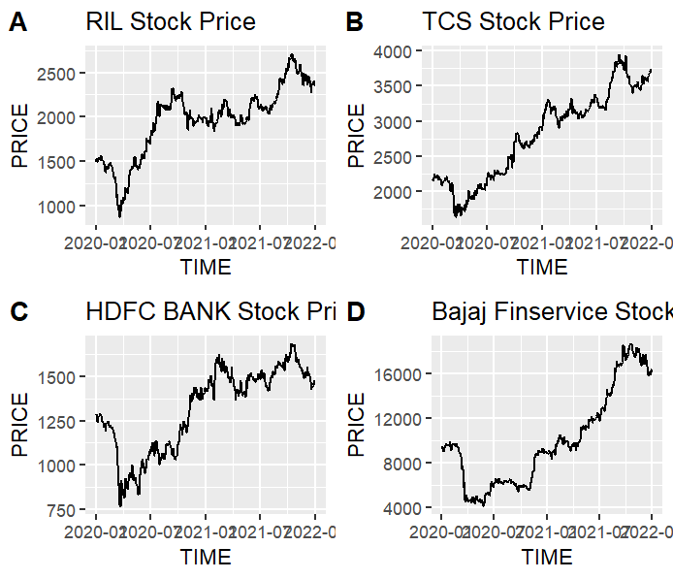
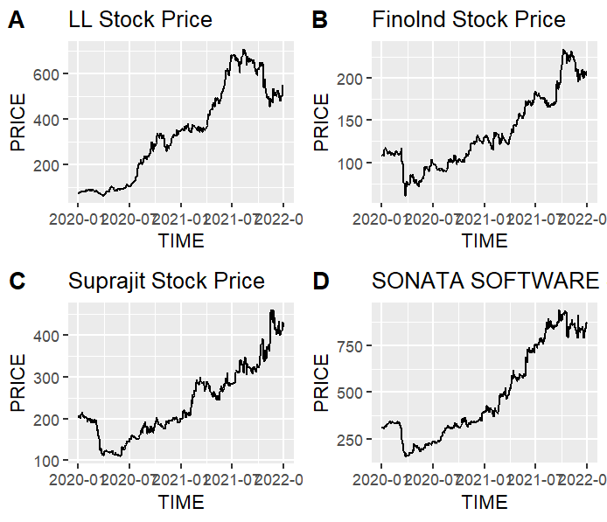
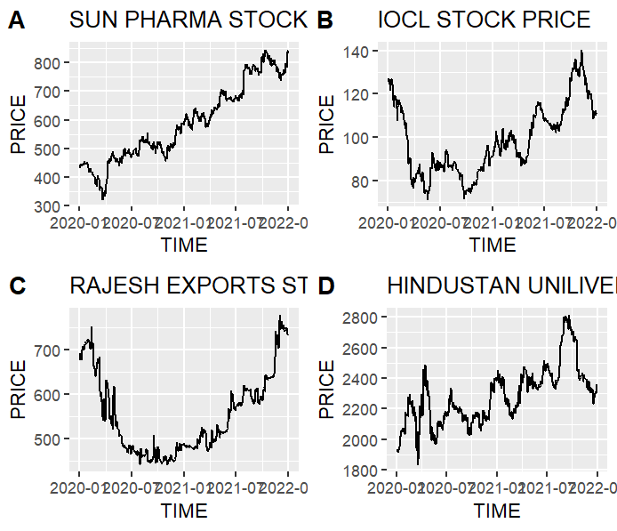
Plotting Data
Defensive Portfolio
Aggressive Portfolio
Rising Giants Portfolio

Slide 19
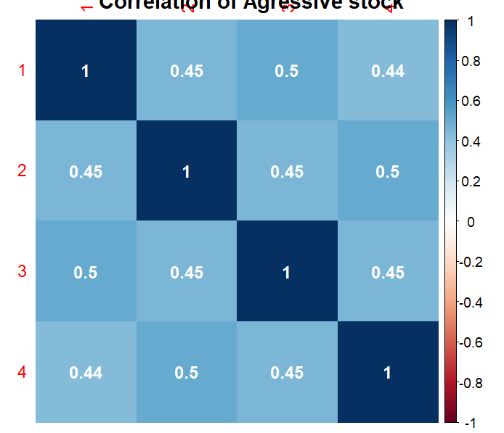
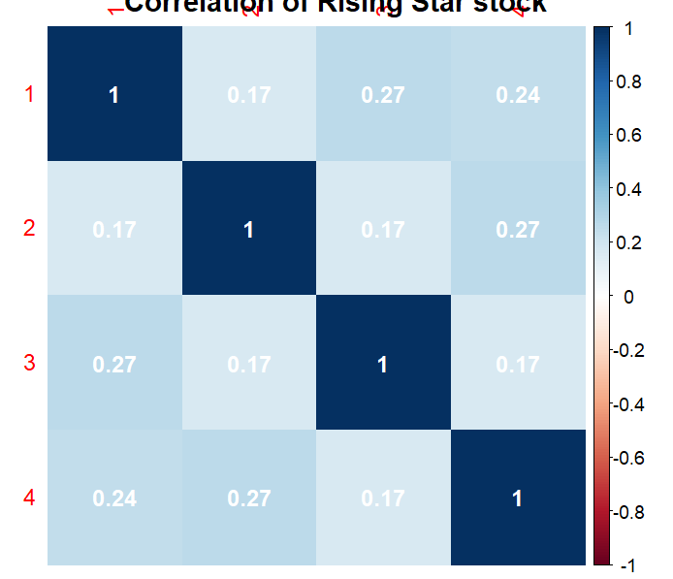
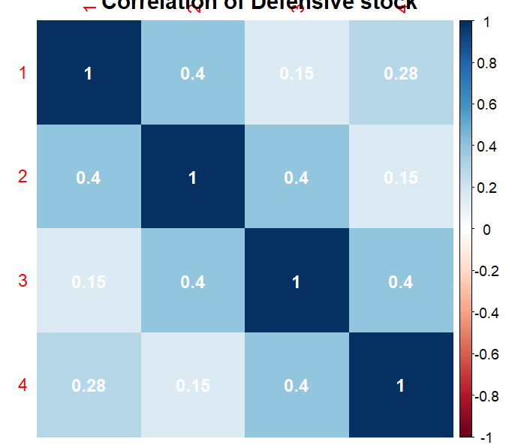
Correlation Matrix
Defensive Portfolio
Aggressive Portfolio
Rising Giants Portfolio

Slide 20


Log Return
Log returns effectively capture the compounding effect.
The compounding of returns of stocks can be easily understood by assuming the normal distribution
r_{i} = ln($\frac{p_{i}}{p_{i−1}}$)
Portfolio Return
The simple net return of a portfolio consisting of N assets is a weighted average of the simple net returns of the assets involved, where the weight on each asset is the percentage of the portfolio’s value invested in that asset.
r_{p,t} ≈ $\sum_{i=1}^{N}{w}$_{i}r_{it}

Slide 21

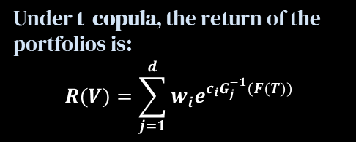
Fitting Of Models
T- Copula Model
The t copula is defined as a model to represent the dependence structure reserved in a multivariate t distribution.
Under normal copula, the return of the portfolios is:
$$R(Z)=\sum_{j=1}^{d}{w_{j}e^{G_{j}^{−1}(φ(\tilde{Z_{j})})}}$$
Normal Copula Model
The Gaussian copula is a distribution over the unit hypercube . It is constructed from a multivariate normal distribution over. by using the probability integral transform.
Under t-copula, the return of the portfolios is:
$$R(V)=\sum_{j=1}^{d}{w_{i}e^{{c_{i}G}_{j}^{−1}(F(T))}}$$

Slide 22
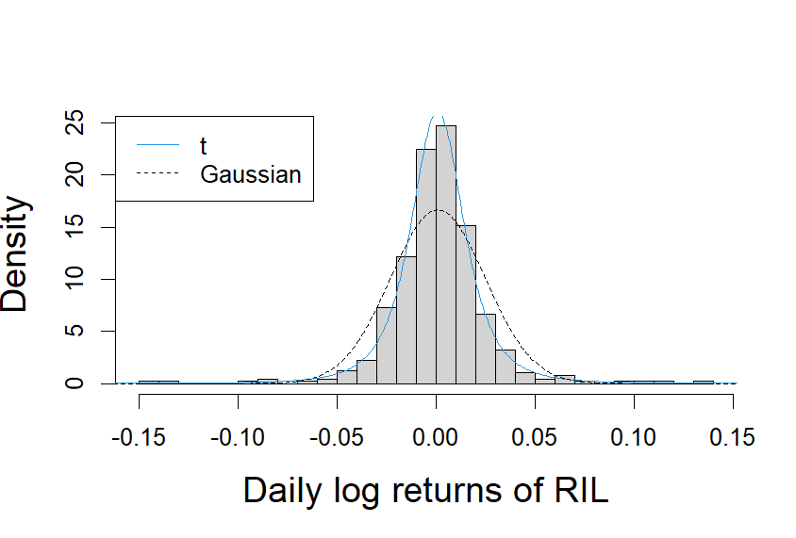
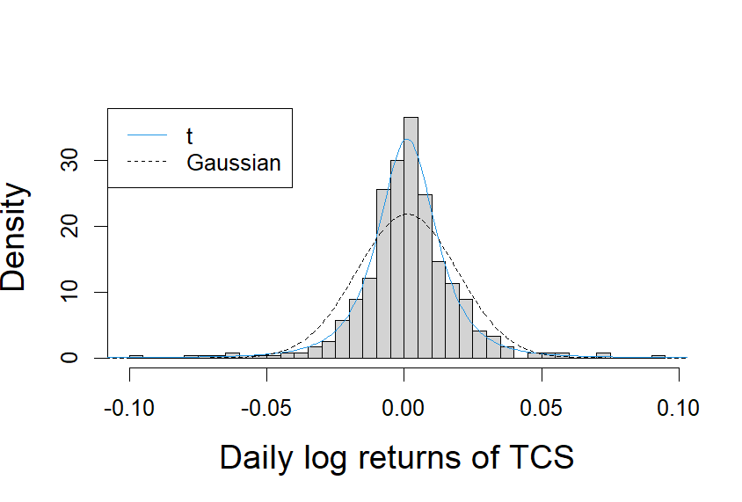
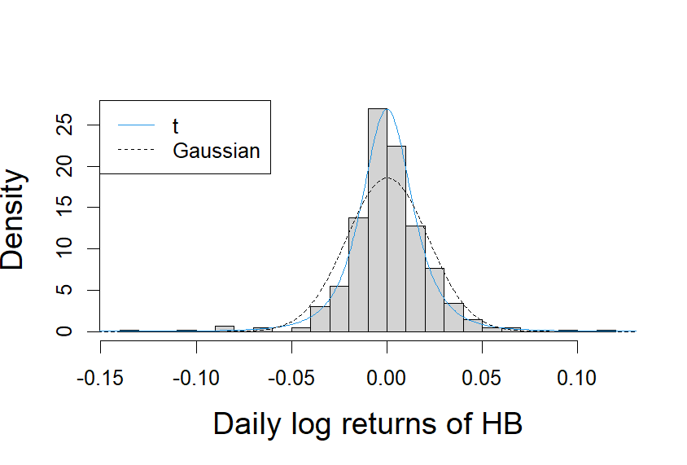
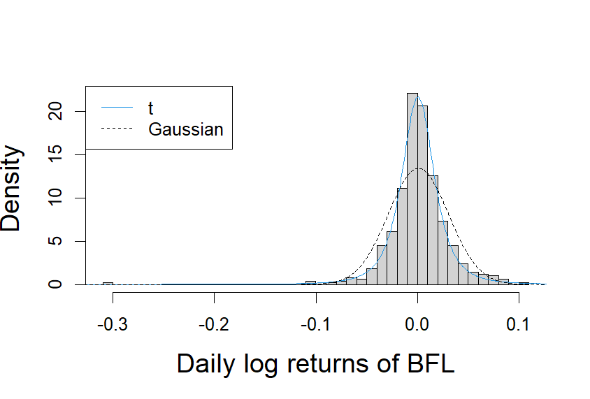
Histogram & Density Plot of
t & Gaussian Copula
Aggressive Portfolio

Slide 23
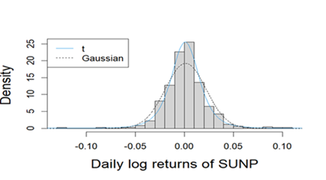
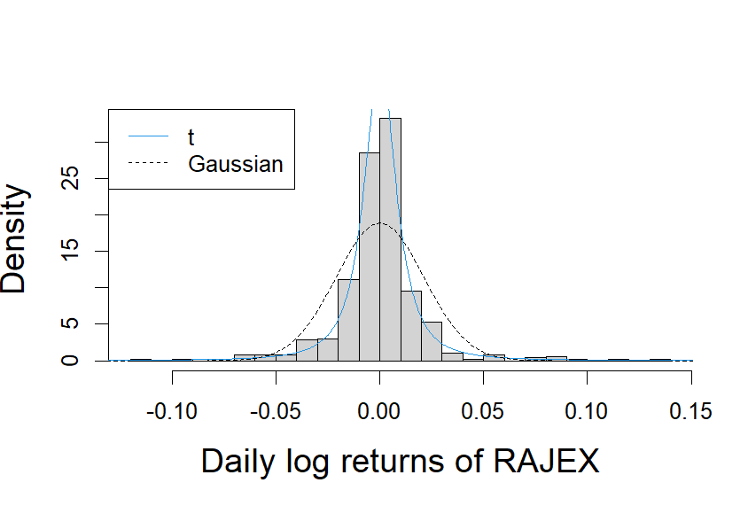
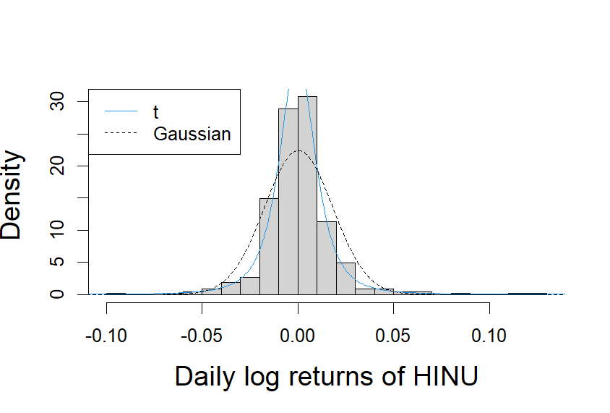
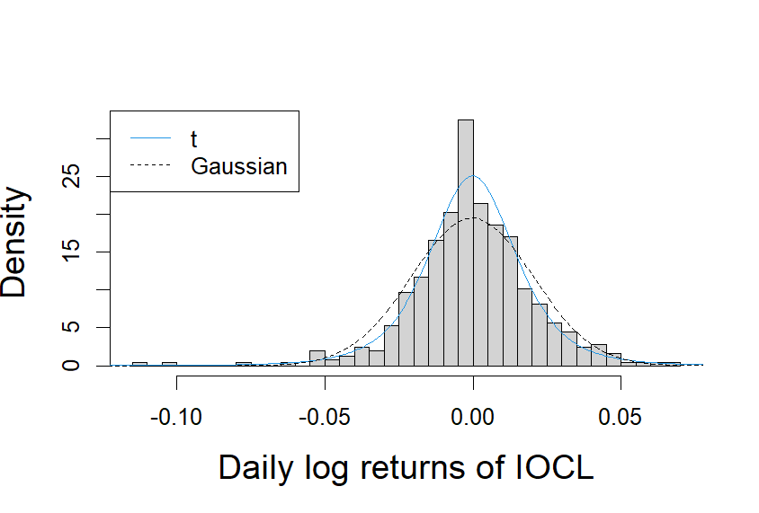
Defensive Portfolio

Slide 24
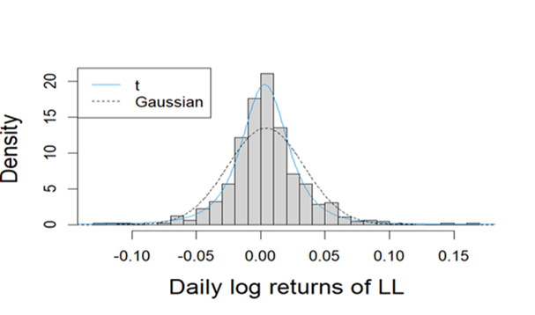
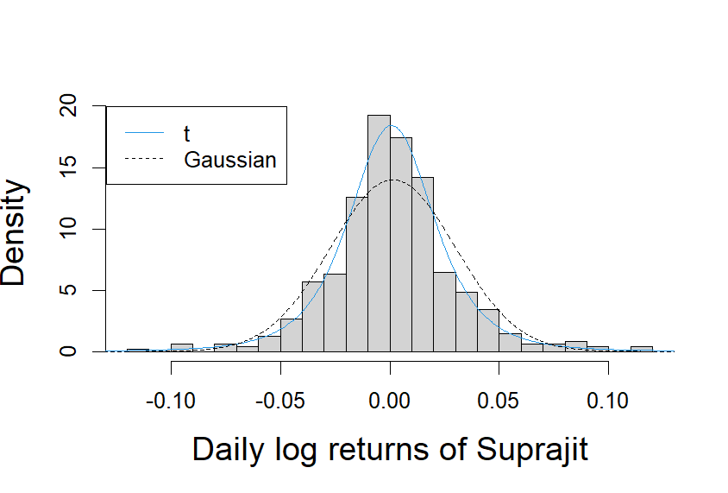
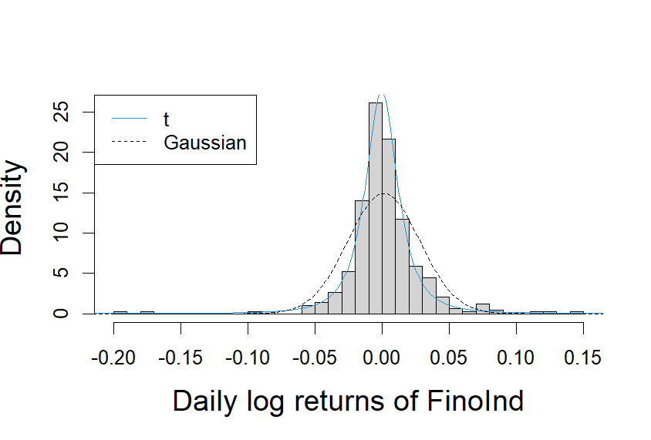
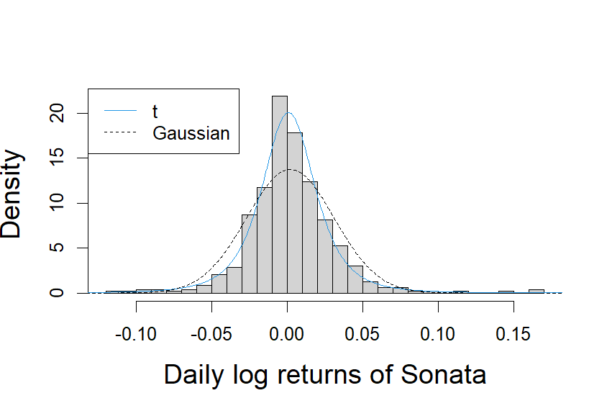
Rising Giants Portfolio

Slide 25

Criteria to check best fit Copula
The log likelihood function of the copula:
Max$\sum_{t=1}^{T}{\text{ln}\text{(}\text{F}\text{j}\text{(}x_{1}^{t}\text{;}\text{β}\text{1}\text{),…,}\text{F}\text{d}\text{(}x_{d}^{t} \text{;}\text{β}\text{d}\text{);}\text{a}\text{),} j=}1,…,a$
Akaike Information Criterion (AIC):
NE : Estimated number of parameters
AIC = -2 Loglik + 2*NE
Higher Value of Loglikelihood
Lower Value of AIC

Slide 26
Model Comparison
Aggressive Portfolio
Defensive Portfolio
Rising Giants Portfolio
Normal copula
Normal copula
Normal copula
 | loglikelihood | aic
RIL | 1143.151 | -2282.3
TCS | 1275.954 | -2547.91
HB | 1197.235 | -2390.47
BFL | 1036.594 | -2069.19
 | loglikelihood | aic
SUNP | 1214.209 | -2424.42
IOCL | 1204.364 | -2404.73
RAJEX | 1289.398 | -2574.8
HINU | 1220.654 | -2437.31
 | loglikelihood | aic
LL | 1038.733 | -2073.47
FinoInd | 1088.406 | -2172.81
Suprajit | 1057.24 | -2110.48
Sonata | 1047.706 | -2091.41
T- copula
T- copula
T- copula
 | loglikelihood | aic
RIL | 1224.895 | -2443.79
TCS | 1337.613 | -2669.23
HB | 1255.995 | -2505.99
BFL | 1120.334 | -2234.67
 | loglikelihood | aic
SUNP | 1254.531 | -2503.06
IOCL | 1343.34 | -2680.68
RAJEX | 1383.183 | -2760.37
HINU | 1248.077 | -2490.15
 | loglikelihood | aic
LL | 1085.525 | -2165.05
FinoIand | 1196.033 | -2386.07
Suprajit | 1083.91 | -2161.82
Sonata | 1104.355 | -2202.71

Slide 27
Model Comparision for Portfolios using Maximum Log Likelihood Method
Aggressive Portfolio
Defensive Portfolio
Rising Giants Portfolio
Normal Copula | 178
t Copula | 210.9
Normal Copula | 57.92
t Copula | 89.15
Normal Copula | 58.03
t Copula | 73.43

Slide 28
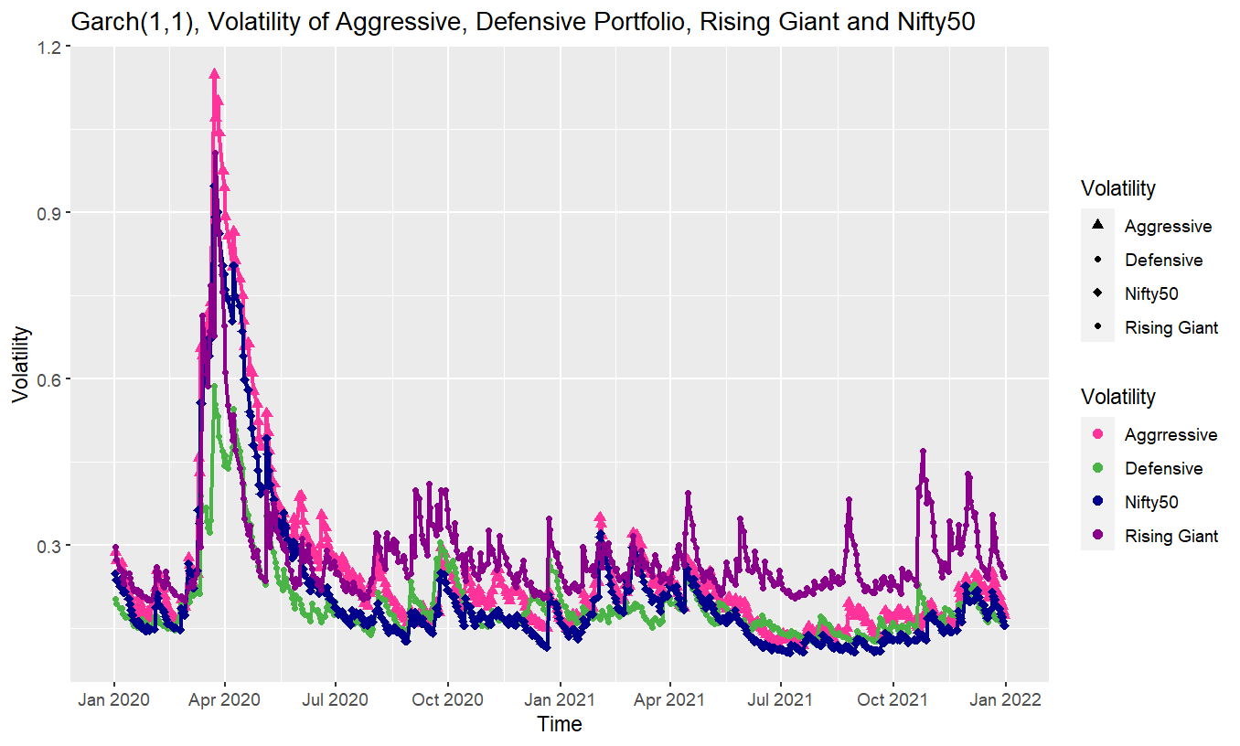
Garch (1,1)
The generalized autoregressive conditional heteroskedasticity (GARCH) process is an approach to estimating the volatility of financial markets.
Financial institutions use the model to estimate the return volatility of stocks, bonds, and other investment vehicles.
σ²_{t}=ω+α₁u²_{t−1}+β₁σ²_{t−1}

Slide 29
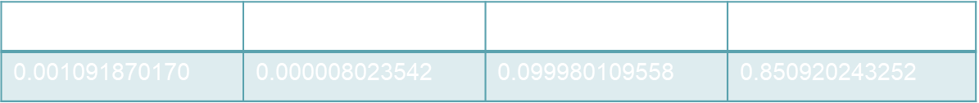
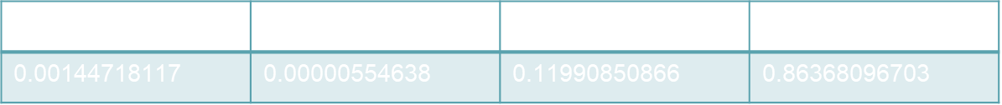
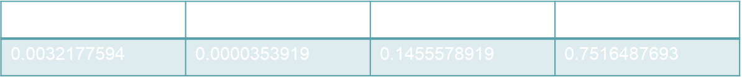
Coefficients of Garch
AGGRESSIVE PORTFOLIO :
µ | omega | $$α_{1}$$ | $$β_{1}$$
0.00144718117 | 0.00000554638 | 0.11990850866 | 0.86368096703
DEFENSIVE PORTFOLIO :
µ | omega | $$α_{1}$$ | $$β_{1}$$
0.001091870170 | 0.000008023542 | 0.099980109558 | 0.850920243252
RISING GIANTS PORTFOLIO :
µ | omega | $$α_{1}$$ | $$β_{1}$$
0.0032177594 | 0.0000353919 | 0.1455578919 | 0.7516487693

Slide 30
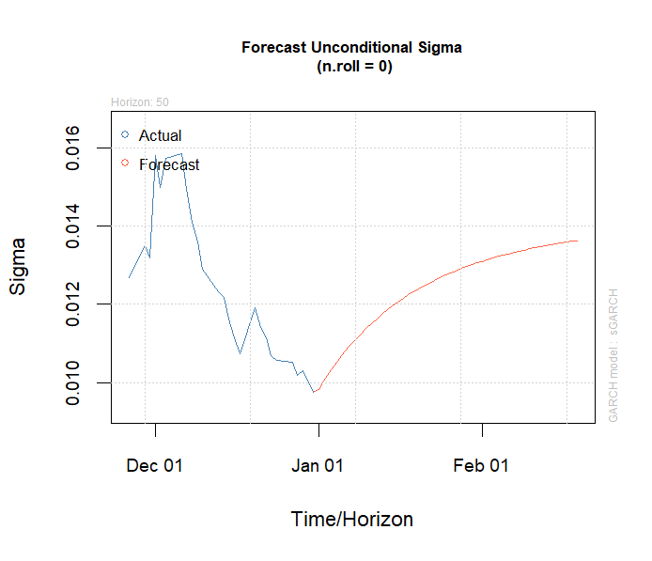
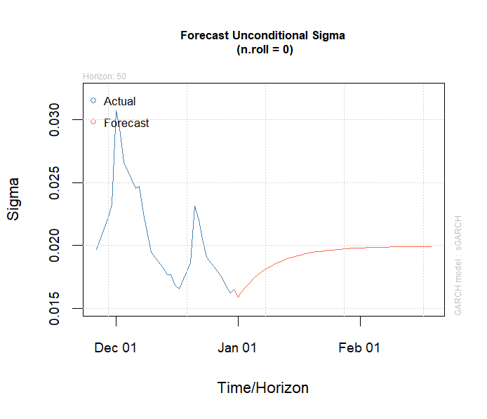
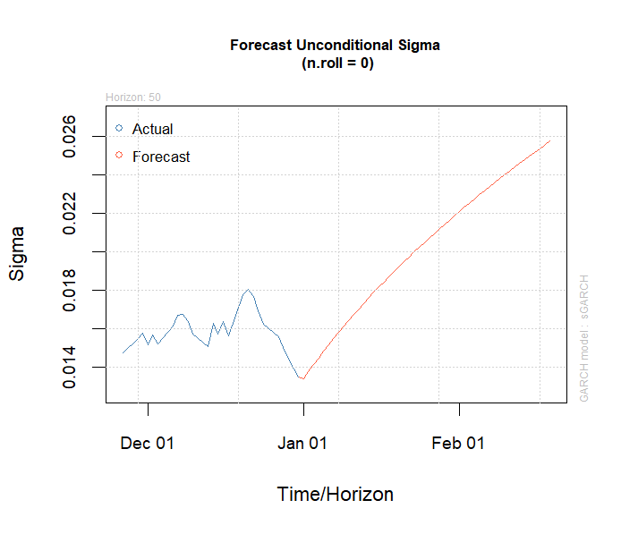


Forecast of Volatility
$l$ step ahead forecast for garch (1,1)
model :
$σ_{h}^{2}\left(l\right)$=ω$\left[\frac{1−{{(α}_{1}+β_{1})}^{l−1}}{1−{(α}_{1}+β_{1})}\right]+{{(α}_{1}+β_{1})}^{l−1}$ $σ_{h}^{2}\left(1\right)$
Aggressive stocks
Defensive stocks
Rising Giants Portfolio

Slide 31
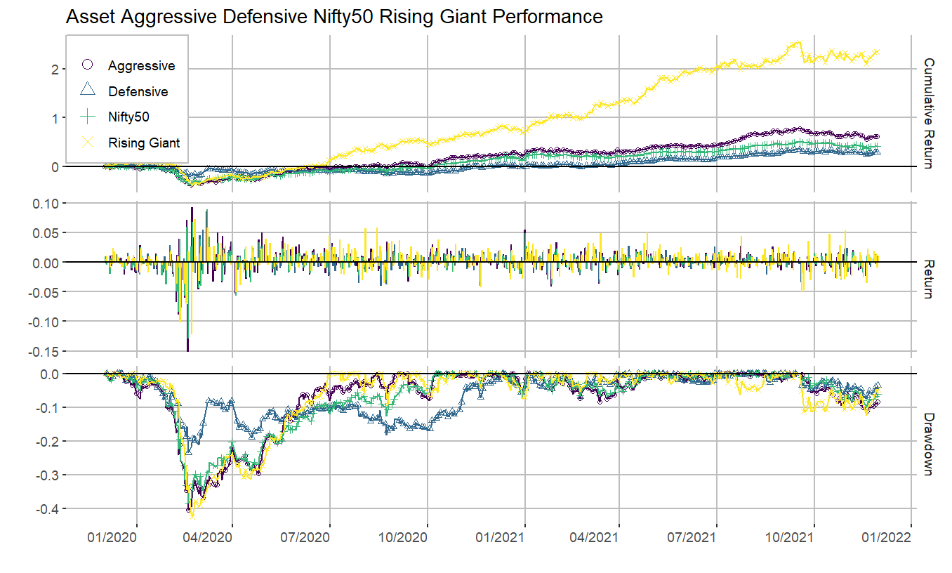
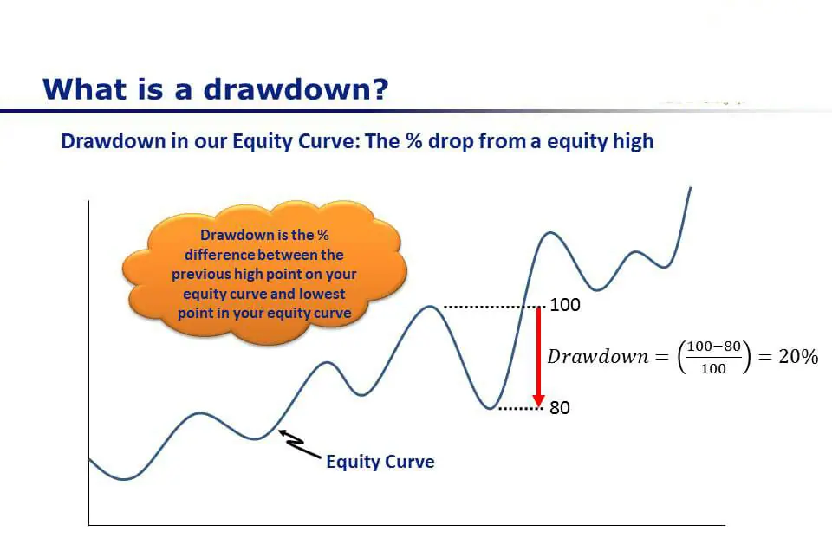
Drawdown

Slide 32

Cumulative Returns
Cumulative return can be defined as the total gain of loss that an investment would
generate which is irrespective of time period
$$\frac{\text{Current} \text{Price}\text{ − }\text{Original} \text{Price} }{\text{Original} \text{Price} }$$

Slide 33
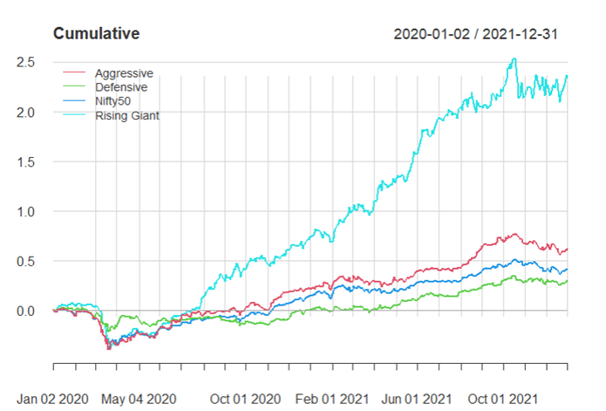
Cumulative Returns for Equal Weights

Slide 34

Portfolio optimization
Portfolio optimization is nothing but a process where an investor receives the right guidance with respect to selection of assets from the range of other options and in this theory projects/programs are not valued on an individual basis rather the same is valued as a part of a particular portfolio.

Slide 35
Optimised Weights
Aggressive Portfolio
Defensive Portfolio
Rising Giants Portfolio
 | Optimised Weights
RIL | 0.22
TCS | 0.32
HB | 0.10
BFL | 0.36
 | Optimised Weights
SUNP | 0.38
IOCL | 0.24
RAJEX | 0.13
HINU | 0.25
 | Optimised Weights
LL | 0.32
FinoIand | 0.23
Suprajit | 0.23
Sonata | 0.22

Slide 36
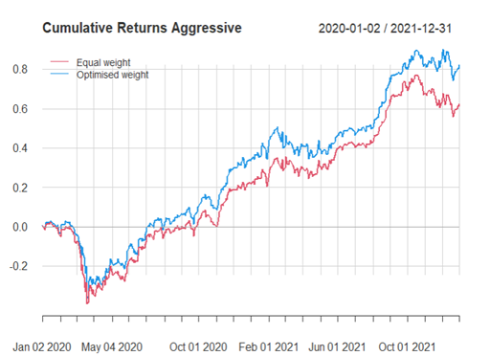
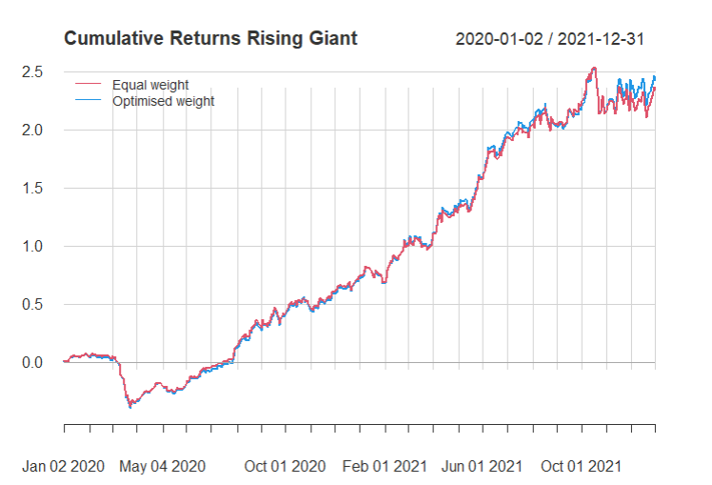

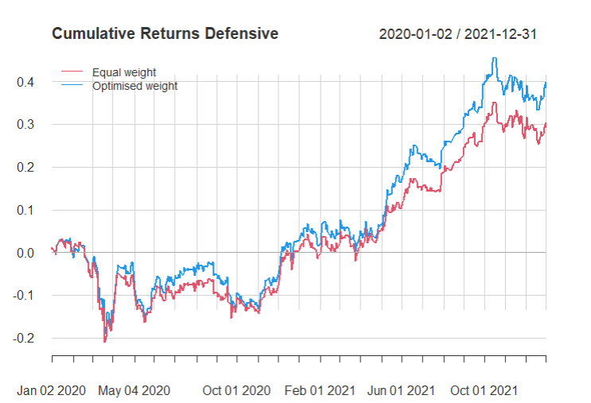
Defensive stocks
VaR
Equal weight – 1.1582
Optimal weight – 1.2351
Extra Return – 9%
Aggressive Portfolio
Rising Giants Portfolio
VaR
Equal weight – 1.3367
Optimal weight – 1.4214
Extra Return – 19.76%
VaR
Equal weight – 1.6026
Optimal weight – 1.6011
Extra Return – 8%

Slide 37
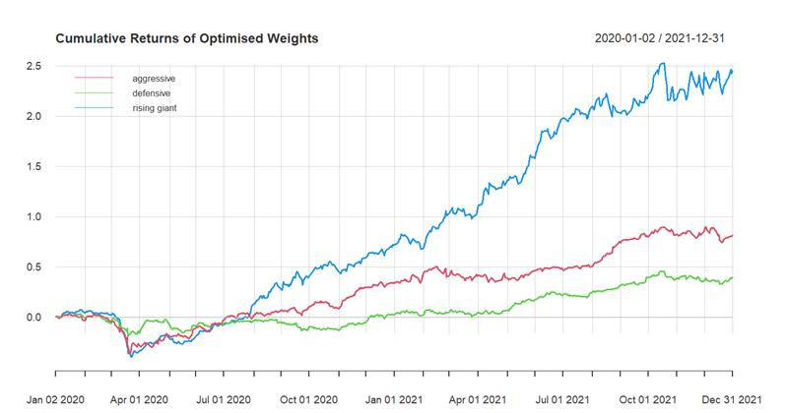
Cumulative Returns for Optimised Weights

Slide 38
Application of the Analysis
Initial amount to invest – 1,00,000
Equal Weights
 | stock | buy price | shares | invested amt | bonus | corpus
rising giants | laurus labs | 74.00 | 338.00 | 25012.00 |  | 182249.60
 | sonata sftw | 312.00 | 80.00 | 24960.00 |  | 70056.00
 | suprajit engg | 200.00 | 125.00 | 25000.00 |  | 53718.75
 | finloex ind | 107.85 | 232.00 | 25021.20 | 1160.00 | 239946.00
 |  |  | Total | 99993.20 |  | 545970.35
Optimised Weights
 | stock | buy price | shares | invested amt | bonus | corpus
rising giants | laurus labs | 74.00 | 433.00 | 32042.00 |  | 233473.60
 | sonata sftw | 312.00 | 70.00 | 21840.00 |  | 61299.00
 | suprajit engg | 200.00 | 115.00 | 23000.00 |  | 49421.25
 | finloex ind | 107.85 | 214.00 | 23079.90 | 1070.00 | 221329.50
 |  |  | Total | 99961.90 |  | 565523.35

Slide 39
Conclusion
By comparing the performance of portfolios, Rising Giants portfolio shows higher profitability with low volatility.
However, in contrast, the higher volatility of aggressive portfolio directly indicates high risk and it may not imply higher return. Thus, to measure the performance of the cumulative return, Rising Giants portfolio shows great advantage when compared to the Aggressive and Defensive portfolios.
Optimised weights are more reliable than equal weights since they produced higher returns.
Not going the conventional way of investing in companies that have already made it big (completely) but also looking for companies that are constantly growing at a good rate/pace and can be the next TCS or next Titan or next Bajaj Finance so we should keep an eye on these Rising Giants to become next Rakesh Jhunjhunwala.

Slide 40

Limitations
Change of optimized weights with time.
For Rising Giants portfolio it does not guarantee multi-bagger returns.
Theoretically calculated returns can not be exactly obtained in real life.

Slide 41

Future Scope
Risk prediction using VaR.
Backtesting of VaR.
Implementing Coffee Can investment strategy on different stocks and monitoring them.

Slide 42
Thank You

